Slide 1
Dartmoor Zoo
By Adam and Tommy

Slide 2
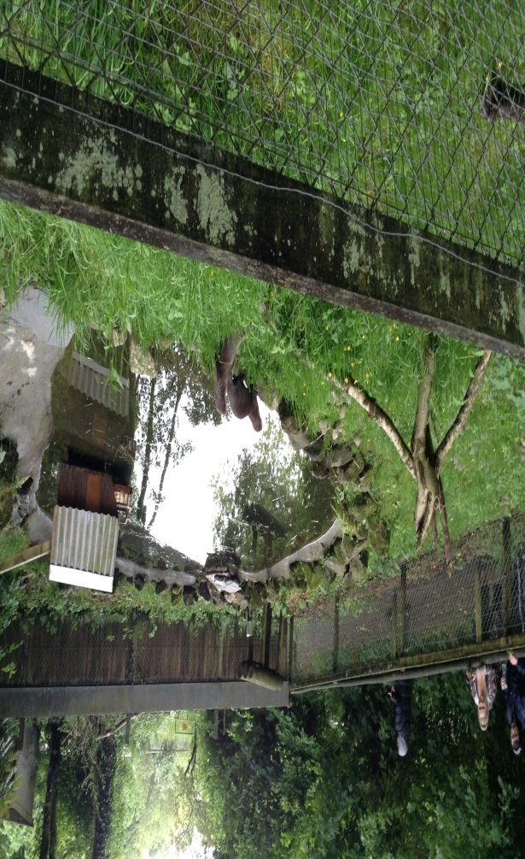
What Happened
On Tuesday 11th June 2019 year 6 went to Dartmoor zoo. We arrived by a coach

Slide 3
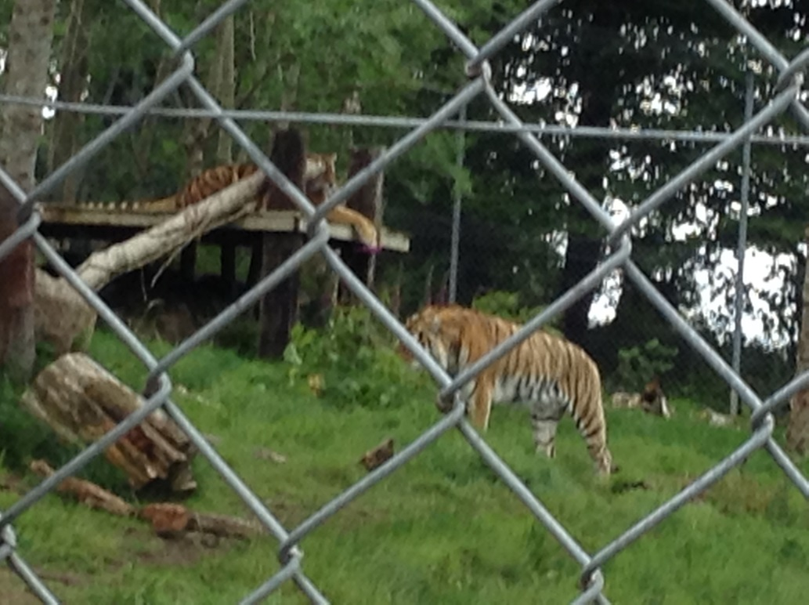
Tigers
We saw the feisty Tigers and one of them was on a huge rock this is because he was the almost the alpha male he was responsible for making sure everything was safe

Slide 4
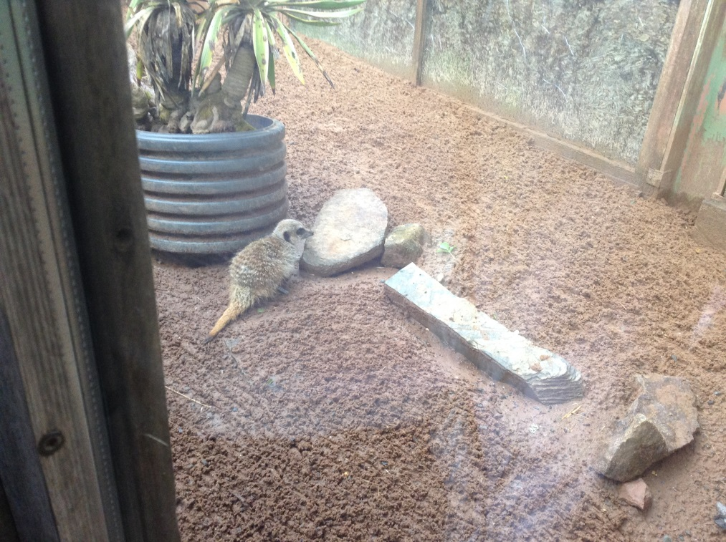
Meerkats
The Meerkats was the first show we saw.
They looked really cute and fluffy.
The mother Meerkat was always on guard protecting her two children

Slide 5
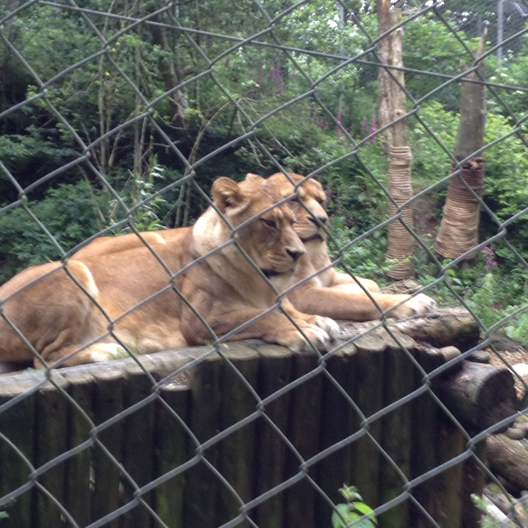
LIONS AND LIONNESSESS
As well as Tigers we also saw the Lions and Lionesses they were in separate cages we arn’t sure why. What we can say is that the Lion was sleeping. The Lionessess however they was wide awake and also they were massive.

Slide 6
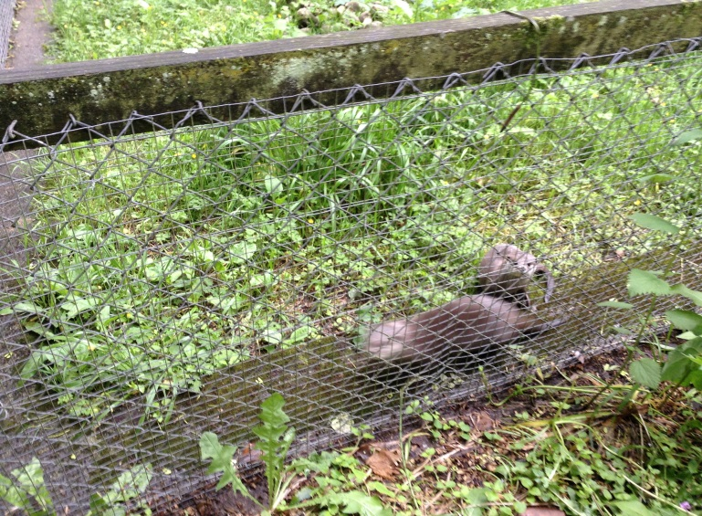
otters
The Otters were by far were the most in the intresting animals in the zoo they were so cute and tiny! They loved to chase each other around but they’re teeth were sharp they may look cute but they were actually deadly. They are amphibious creatures but cant stay in the water for long.

Slide 7
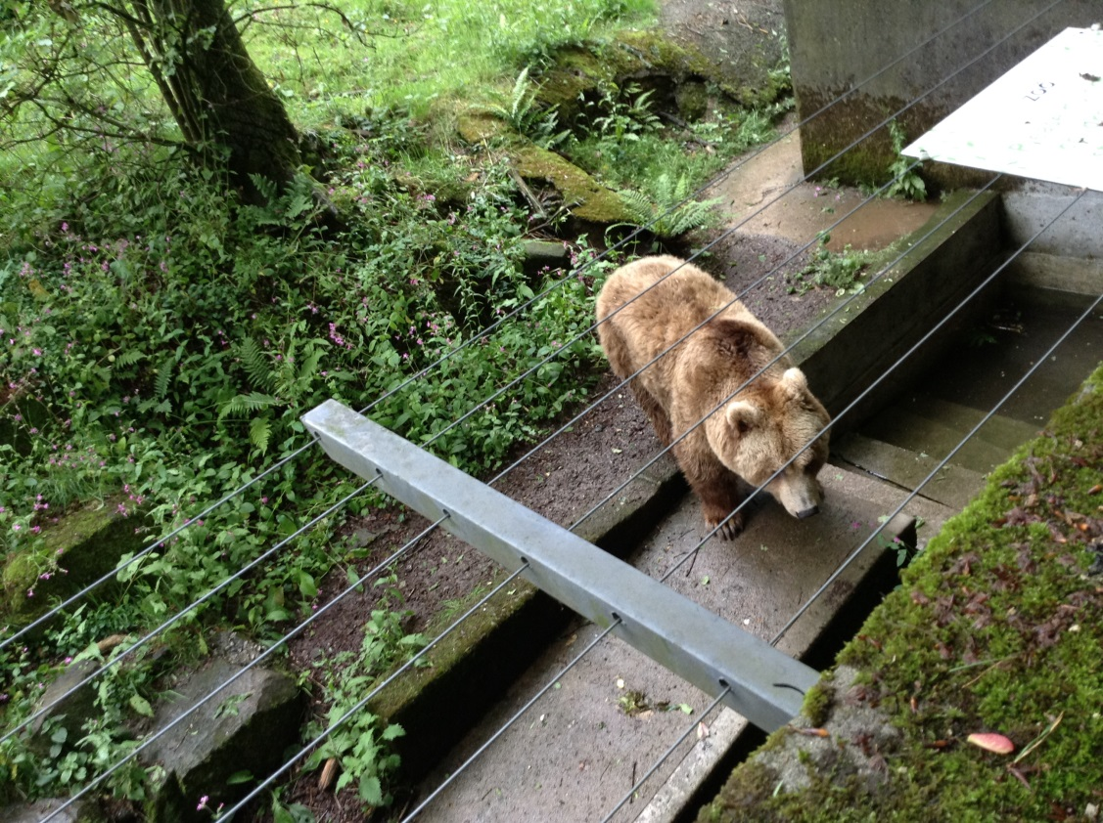
Bear
Haley the European brown Bear was another of the attractions at the zoo she loved to stand near the gate this is due to the fact that she really liked attention.

Slide 8
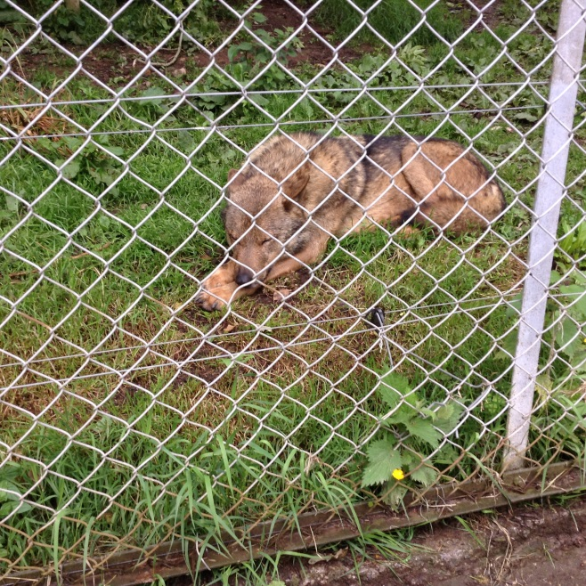
Wolves
The wolves were the most popular animal in our group many of us tried to make them howl
All of us failed.
The most probable explanation into this reason is simply due to the fact they only reacts to the calls of other wolfs

Slide 9
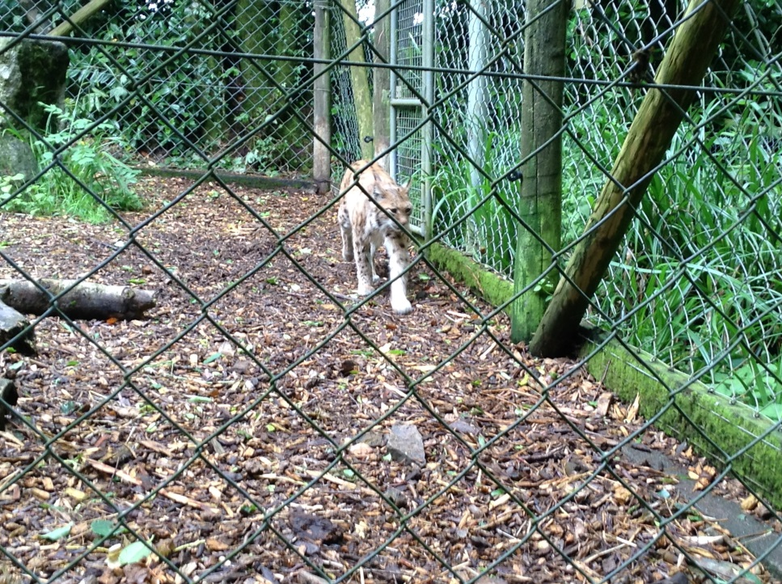
Lynx
One of the lynx’s escaped the zoo back in 2016 as it was at the stage of its life where it was searching for a mate. The lynx has really pointy ears for hearing and it is kind of fast as well and it bury’s its food

Slide 10
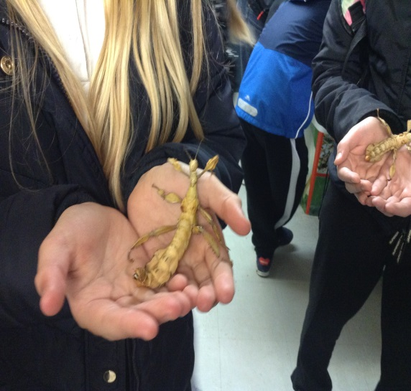
Reptiles/bugs
In our group we went to the reptile house it was also the bug house as well. The picture is of a praying mantis in our hands it felt ticklish as they are quite calm (the pic is on the left)

