Slide 1
Junior Life Skills.
By Zak & Ava.

Slide 2
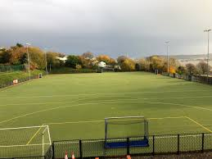
Bull Point.
]
When we arrived at Bull Point, we sat down and ate our lunch. After that we as a school played a game of football then Penny Cross Primary came too. We were then placed into different groups.

Slide 3
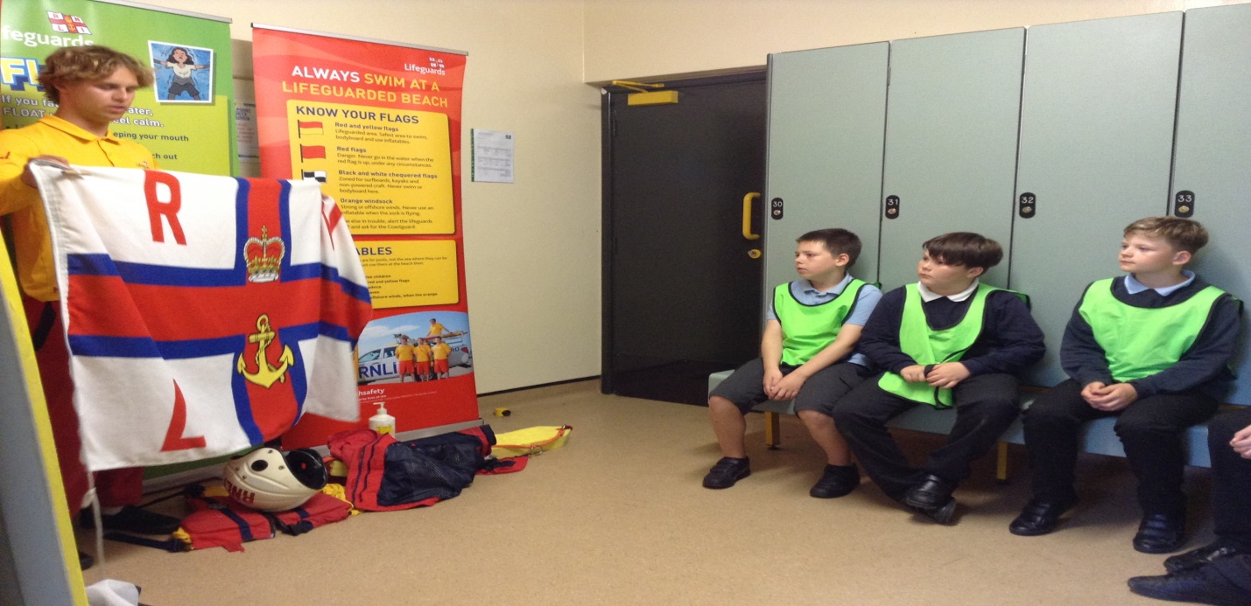
RNLI.
The RNLI stands for The Royal National Lifeboat Institution. The RNLI specialise in helping those who can not help themselves at sea. If there is a problem that The RNLI can not deal with then
They will contact 999 or 112.

Slide 4
Railway Safety.
Two Great Western Railway workers came in to teach us the importance of being safe when at a railway station. They told us that we would get £1000 fine for tresspassing.

Slide 5
Internet Safety.
We learnt how to be safer whilst on the Internet and we had to answer a series of questions in boxes labelled A,B and C. Each questions was connected to a certain word.

