Slide 1
Dartmoor zoo
By Connell and Logan.E

Slide 2
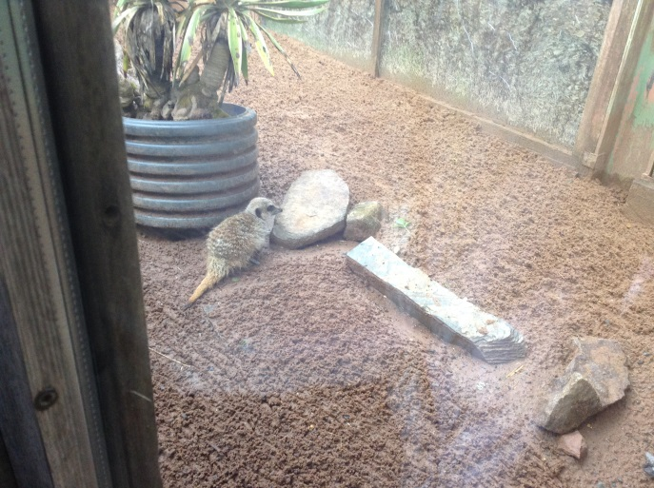
Meer Cats
First of all we saw Meer cats, we learnt facts about them such as what they eat, family sizes and how they hunt.
They eat things like chopped up cucumber and carrots. They live in family's as big as 1 mother and 2 children. They sneak up on their prey to hunt.

Slide 3
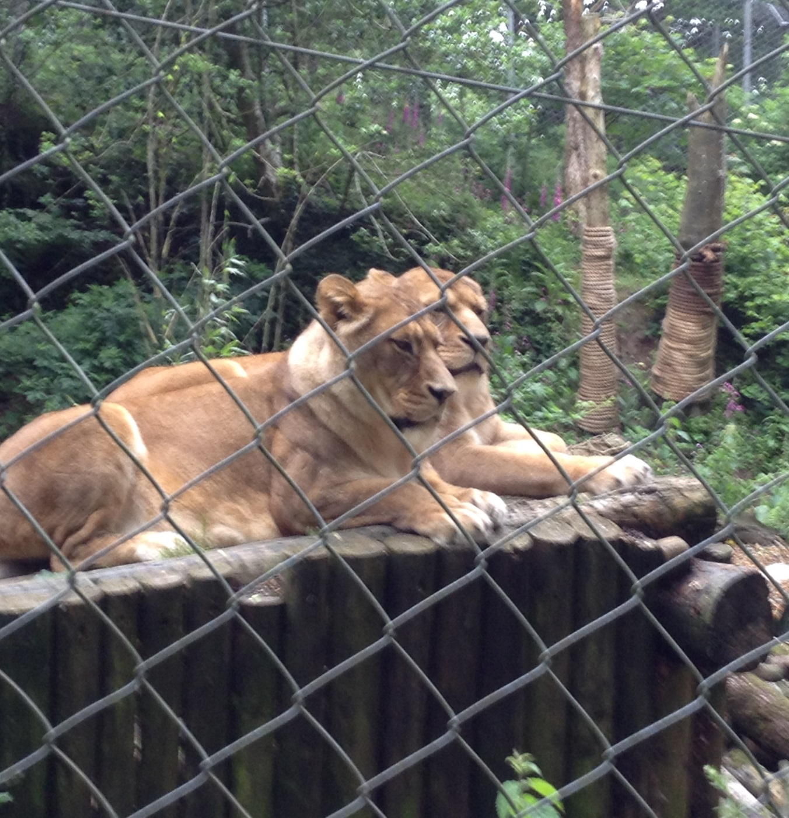
lionesses
We saw Lionesses they mostly slept but things we already know are they eat meat (they are carnivores) they also bite out their own fur.

Slide 4
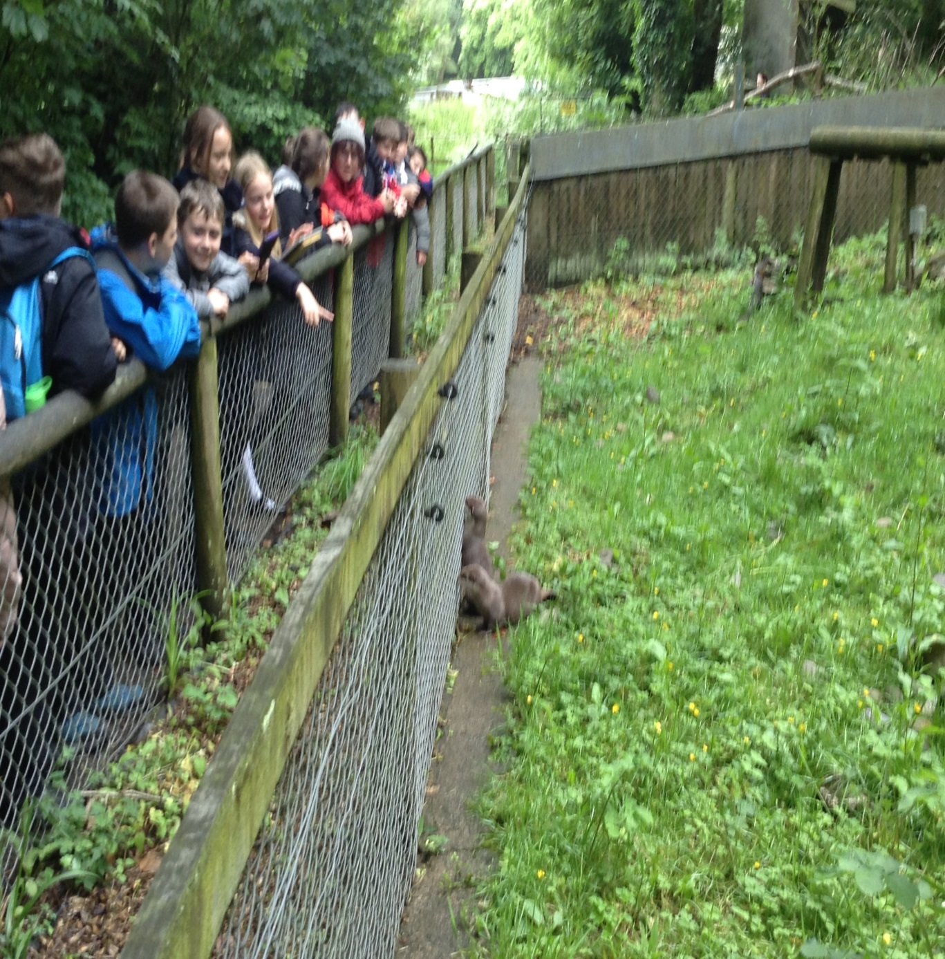
Otter
We also saw Otters we learnt that they have 2 layers of fur to keep them warm and 1 is waterproof. They also have very sharp claws so they can dig and climb up trees to get away from their hunter. If there are more than 2 Otters they are probably a family. They choose a favourite pebble and make it really soft to give to youngsters.

Slide 5
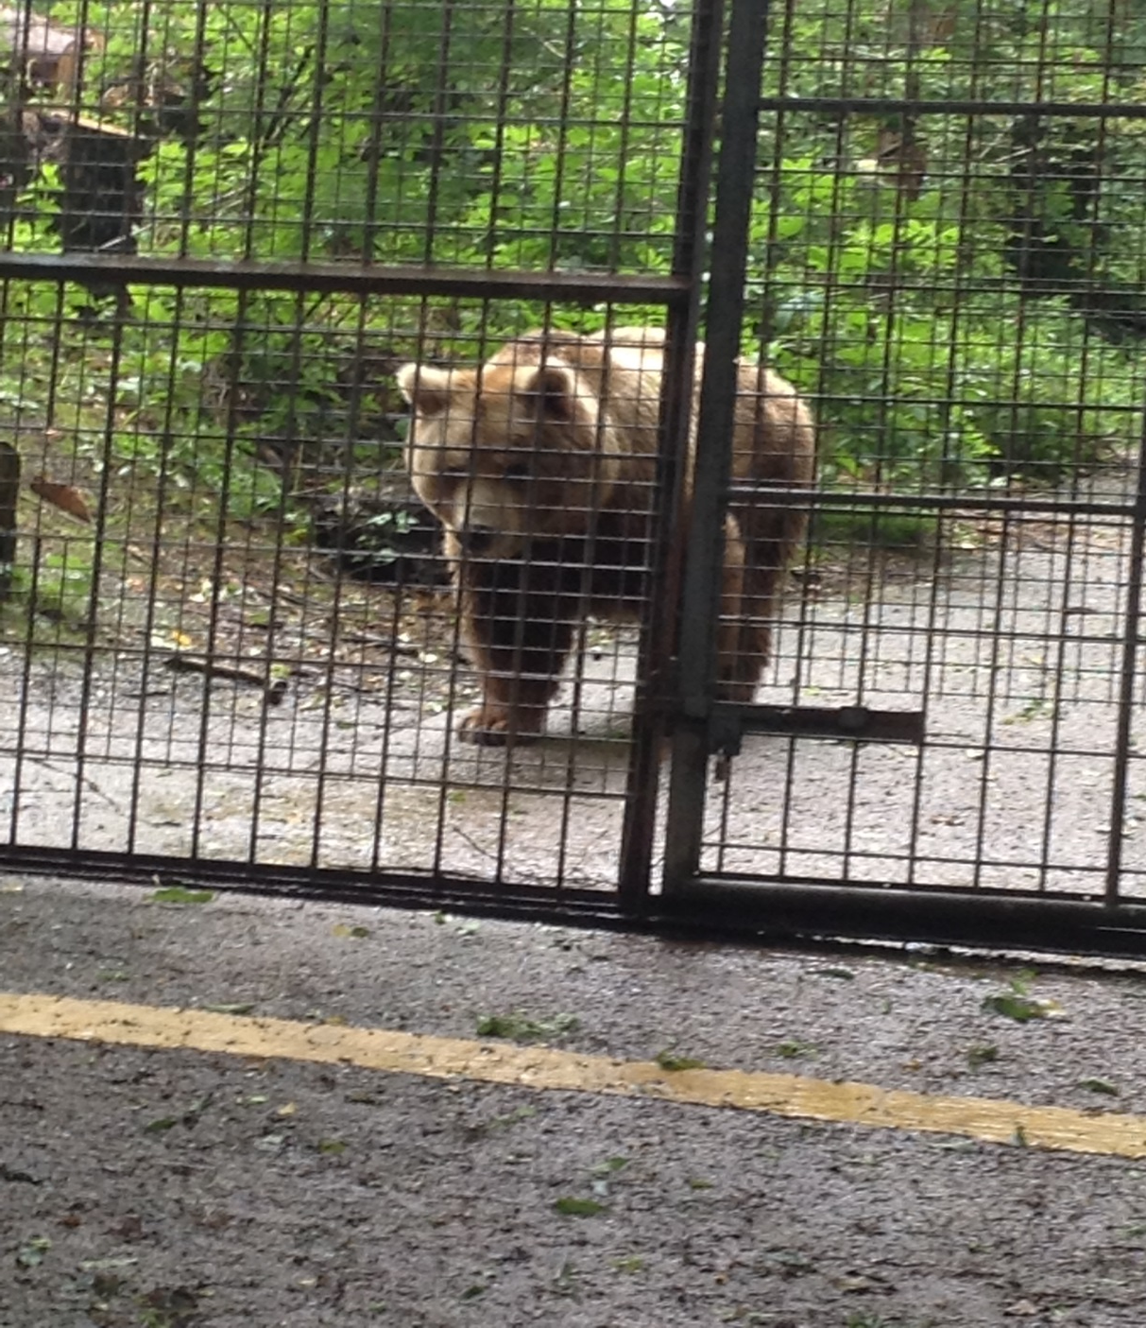
Bears
We also met Haley (a Grizzly Bear) and this is what we learnt. During hibernation they are always half asleep and half awake to eat and sleep. They are also carnivores . She is also the oldest bear in captivity with an age of 33.
They also like honey.

Slide 6
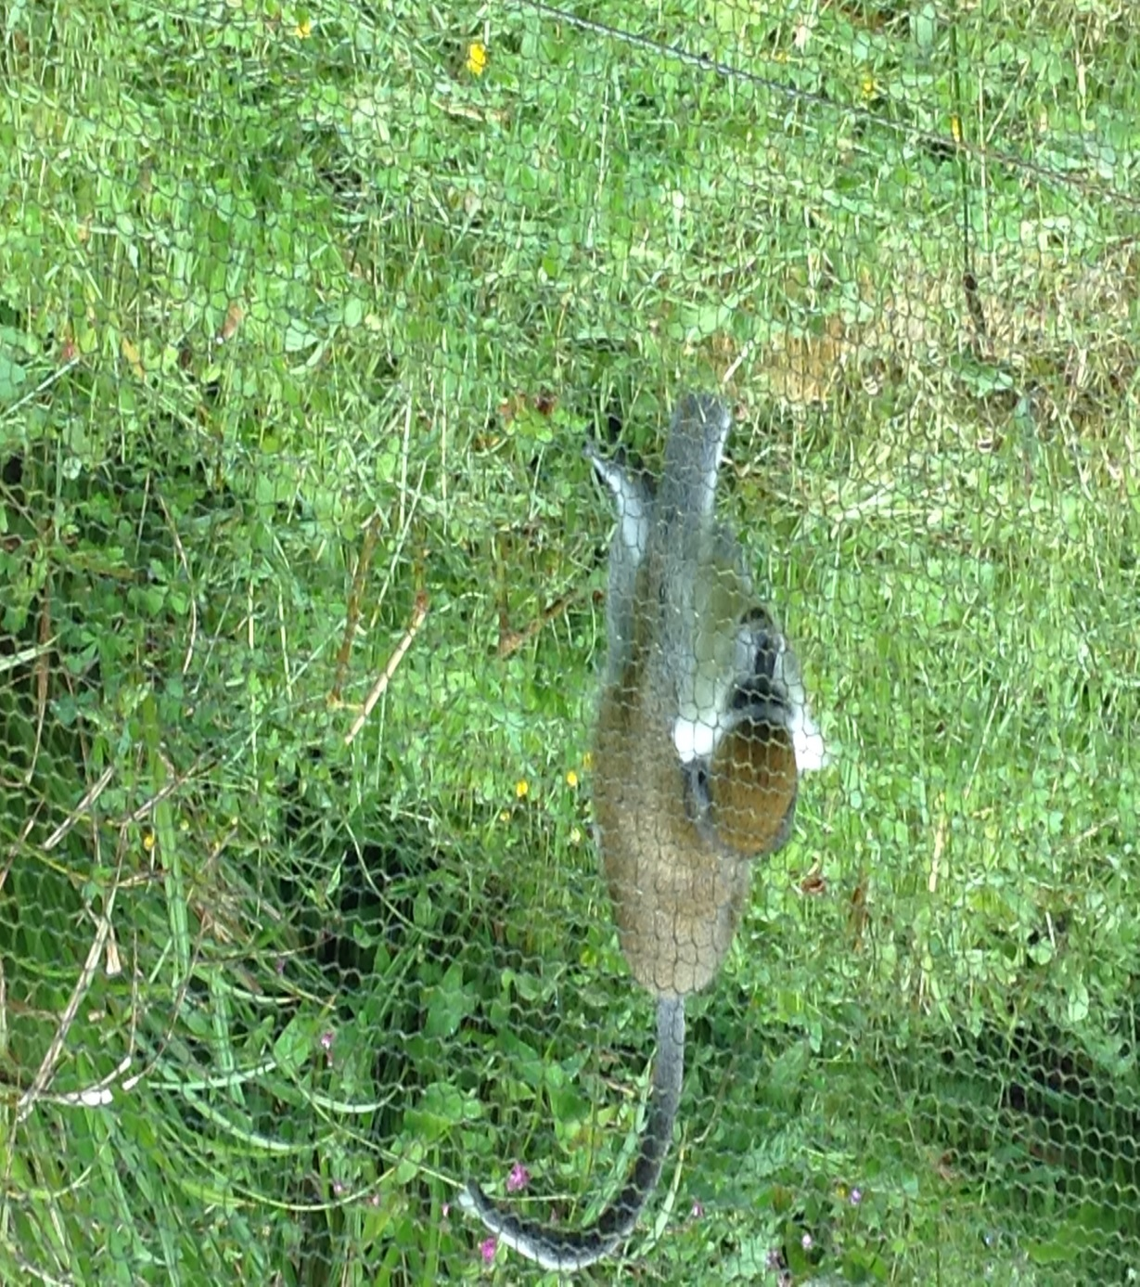
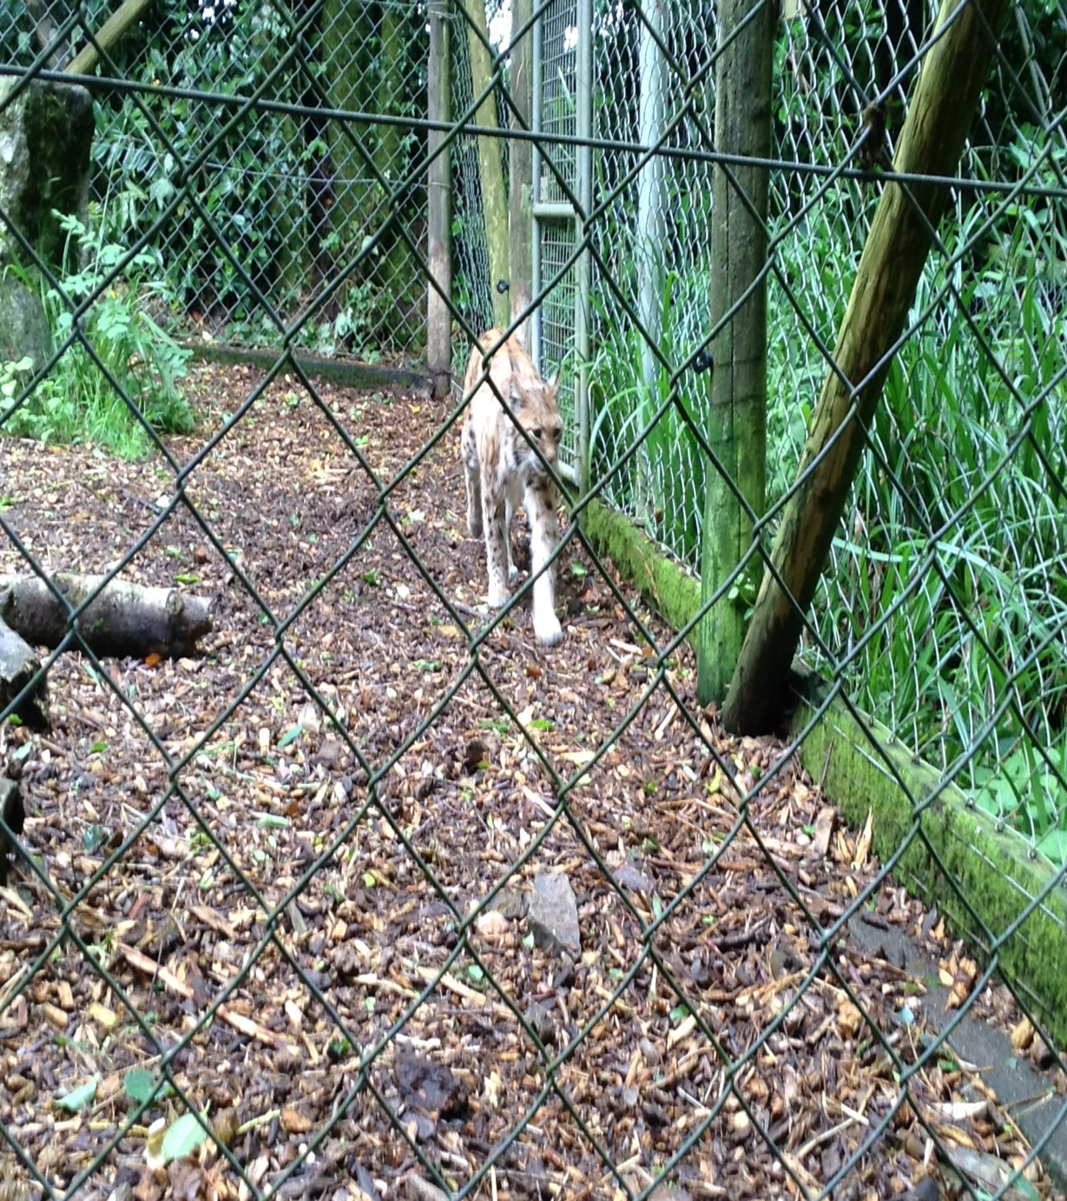
LYNX
We saw Lynx’s and these are the facts. Lynx's are a type of big cat with long legs and whiskers. They are carnivores (they eat meat).

