Slide 2
Why are we here?
To secure the best possible outcomes for the children in our schools
A desire to be in control of our own destiny
Disappearing local authority services

Slide 3
What is a Multi Academy Trust?
At its heart, a Multi Academy Trust is a family of schools forming a shared company, to work in partnership to improve the educational provision and standards for pupils in its member schools.
It is a charitable company, with Trustees/Directors registered at Companies House.
The Trustees/Directors are accountable for the performance of the schools within the trust, much like our existing governing body.

Slide 4
The Principles of the Discovery Multi Academy Trust
All schools treated as an equal partner
No change to the distinctive and individual nature of the schools
To ensure the provision of high quality education for our children
A desire to secure the best possible outcomes for all our children, through the delivery of high quality learning experiences
Maximising the opportunities for the career development of staff, through the sharing of good practice and high quality CPD.

Slide 5
Key Aims for our Trust
Through collaboration, we will:
Ensure consistently high expectations and outcomes across all of our schools, amongst learners, teachers, parents and carers.
Develop opportunities to provide wider life experiences, developing both skills and expertise that help children gain the employment and training that they aspire to.
Work effectively with parents and carers, professionals and the wider community to promote health and well-being, in order to create the right conditions for learners to thrive.
Make efficient use of all resources available to us and thereby maximise the benefits for learners.

Slide 6
Key Aims for our Trust
Enhance the professional development opportunities for all staff, with a greater emphasis on Quality Assurance and support.
Work with external partners, including other schools, to widen the range of life skills available for our communities to develop.
Improve social cohesion within our community by strengthening our commitment to co-operative values, including respect, social justice, fairness, inclusion and democracy. Then using these to do things that help improve our community.

Slide 7
How will the Trust be governed?
3 levels of management:
Members – largely a hands-off role, similar to shareholders in a company.
Trustees/Directors – provide strategic direction for the trust – chosen for their individual skills they can bring to support the development of the Trust.
Local Advisory Boards – similar to our existing governing bodies in each school.

Slide 8
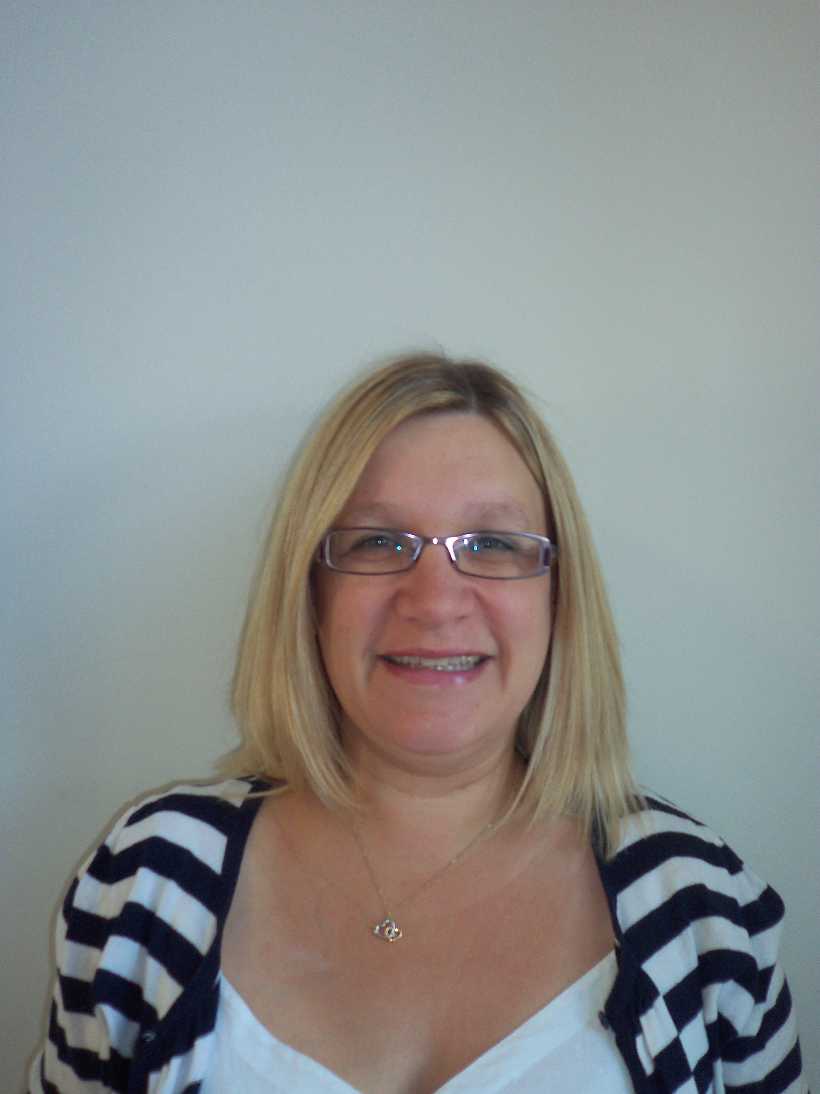
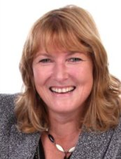
Discovery Multi Academy Trust
Board of Members
Roger Galloway
Member
Co-opted Governor
Al Briggs
Member
Co-opted Governor
Tina Tuohy
Member
Community Governor
Board of Trustees
Carol Lant
Community Governor
Jade Harris
Parent Governor
David Tytherleigh
Chairman of the Board
Alison Nettleship
CEO Designate
Hannah Randall
Parent Governor
Dawn Jones
City College Plymouth
Steve Evans
Plymouth City Council
Oakwood Primary Academy
Weston Mill Community Primary Academy
Beechwood Primary Academy
Local Advisory Board
Local Advisory Board
Local Advisory Board
Head of School
Jackie Sparrow
Head of School
Rachel Dibben
Head of School
Lisa Evans

Slide 9
Teaching and Learning Staffing Structure
CEO
Some centralised services
Beechwood Primary Academy
Weston Mill Community Primary Academy
Oakwood Primary Academy
Head of School
Head of School
Head of School
Assistant Head of School
Assistant Head of School
Assistant Head of School
School Staff
School Staff
School Staff

Slide 10
What changes will we see?
Whilst the overarching aim of the Trust is to promote school improvement and outcomes for pupils and staff, there will be little change to the daily life of children in the classroom.
Parents will notice little or no difference to the daily school life of their child.
Most staff will see no change to their role.
Opportunities for staff to develop their practice through collaboration and high quality CPD.
Roles will evolve as the Trust develops.

Slide 11
How will this affect staff?
Formal consultation will be undertaken in the next few weeks.
Staff are currently employed by Plymouth City Council or the Education Through Enterprise Trust.
Staff will transfer to being employed by the Multi Academy Trust.
Terms and Conditions will not be changed.
Memberships to the Teachers and Local Government Pension Schemes will continue.
There will be increased job security with options to work across the member schools.
Staff will no longer able to use the Plymouth City Council IChoose scheme or workplace options.
The Trust will develop schemes such as childcare voucher schemes for use by staff.
There will be a consistent pay day for teaching and support staff (25th of the month).
We have invited Graeme Catling, our HR advisor, here to answer any initial questions you may have about changes to employment and how this will affect you.

